Slide 1
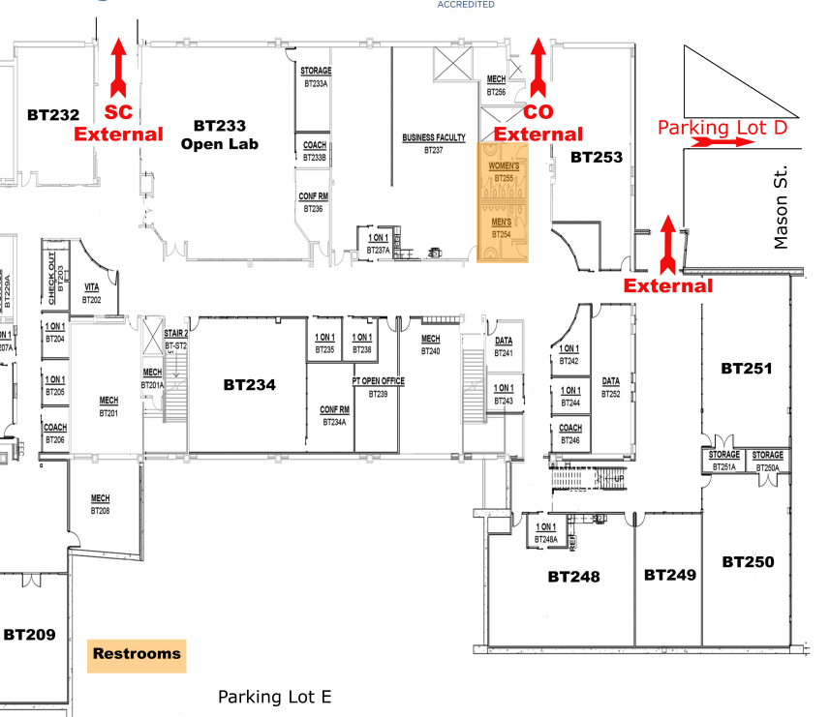
BT232
Student
Lounge
2
3
4
R3
1
5
11
9
10
12
6
7
8
13
Employer
Tables
Registration
Tables

Slide 2
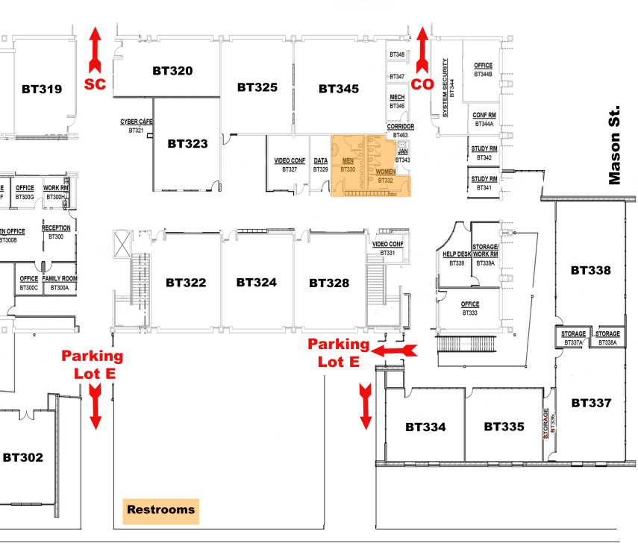
BT319
Employer
Lounge
R1
30
29
25
31
24
27
23
22
32
28
26
33
21
14
34
20
R2
19
15
16
17
18
Employer
Tables
Registration
Tables

